Slide 1
E-bay - E-commerce Website
Under Guidance of Mrs. Vaishali Sonawane Mam.

Slide 2
Introduction :
eBay is a global e-commerce platform that allows individuals and businesses to buy and sell goods and services worldwide. The site provides a marketplace with vast product categories and various buying options including auctions and Buy It Now.

Slide 3
Members of Team
Vaishali Sonawane - Test lead
Sai Bavesh – Team Member

Slide 4
Responsibilities
Create Test plan.
Create Automated testcases in TestNG framework.
Execute all the test cases.
Create defect report.

Slide 5
Overview
What is E-bay?
eBay is an online marketplace where people can buy and sell both new and used items in many categories. It allows sales between individual users as well as businesses and customers, with secure payment options and buyer protection. In this project, I tested eBay’s main features and user interface, checking how real users would interact with the platform to make sure it works smoothly and is easy to use.

Slide 6
Modules
Module 1 : Login in page
Make sure a user can sign in with correct username and password and reach their main page.
Module 2 : multiple search
Check that searching for an item shows the right products with pictures and prices.
Module 3 : Add to cart page
Make sure clicking “Add to Cart” puts the item in your shopping cart and updates the number of items.
Notes:
Module 1: Signn in page
Checked all the functionalities on Sign in page which included personal info as email
address, password
Module 2: Women page
Checked all the functionalities on Women page which included item details, Quantity, Filters,compare button,Add to cart button,product info,grid,list button
Module 3: Tshirt page
Checked all the functionalities on T-Shirt page which included item details, Quantity, Filters,compare button,Add to cart button,product info,grid,list button
Module 4: All Buttons and Drop Down Arrow :
team checked if all the buttons and drop down arrows of different fields are functioning properly or not

Slide 7
Module 4 : delete from cart
Check that you can change the number of items in the cart or remove them and the total price changes correctly.
Module 5 : shop by categories
Make sure clicking on any category (like Electronics or Fashion) shows a list of products from that category.
Module 6 : get product description
Check that when you open any product page, you can see a clear and correct description of the item.
Module 7 : language select
Make sure users can choose their preferred language and the website updates to show all menus and text in that language.

Slide 8
Module 8 : shop by all categories
Check that clicking “Shop by All Categories” shows a complete list of every product category on the site.
Module 9 : change username
Verify users can update their username in account settings and see the new name across the website.
Module 10 : change user address
Make sure users can enter a new shipping address and it gets saved and used for future orders.

Slide 9
Defects
During testing of the eBay homepage, I observed that certain key elements related to live events and sales are not functioning as expected. Specifically, the absence of navigation tools and interactive filters, as well as the lack of product thumbnails and visual cues for listings, significantly degrade the user experience.
These issues prevent users from easily discovering and engaging with promotional content, representing critical defects in the frontend user interface

Slide 10
Defect identifier :- E-Bay_001
Defect summary :- E-bay live shows long list of live events headlines without navigation, categories and filters
Ø Test Id :- TC_001
Ø Test case name :- TC_No_liveevents_navigation
Ø Module name :- homepage – live events
Ø Reproducible :- yes
Ø Severity :- high
Ø Priority :- critical
Ø Raised by :- sai bavesh
Ø Assigned to :- developer Team
Ø Date of assignment :-
Ø Status :- pending
Ø Snap shots :-
Ø Fixed by :- developer
Ø Date of fixing :-

Slide 11
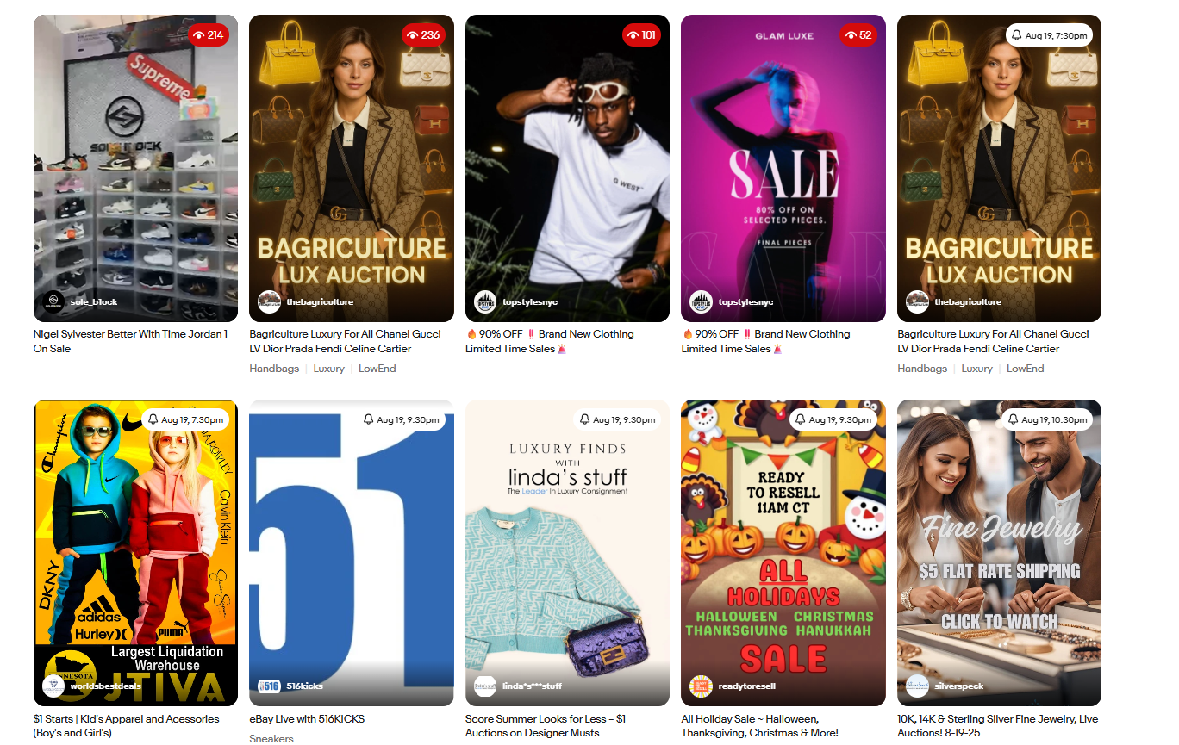

Slide 12
Defect identifier :- E-bay_002
Ø Defect summary :- Only textual information is displayed for categories and listings. No product or category images/thumbnails appear and when selected give 0 results
Ø Test Id :- TC_002
Ø Test case name :- TC_Categories_Thumbnails_and Products Missing
Ø Module name :- Homepage - collectables and art Section
Ø Reproducible :- yes
Ø Severity :- high
Ø Priority :- Critical
Ø Raised by :- sai bavesh
Ø Assigned to :- developer Team
Ø Date of assignment :-
Ø Status :- pending
Ø Snap shots :-
Ø Fixed by :- developer
Ø Date of fixing :-

Slide 13
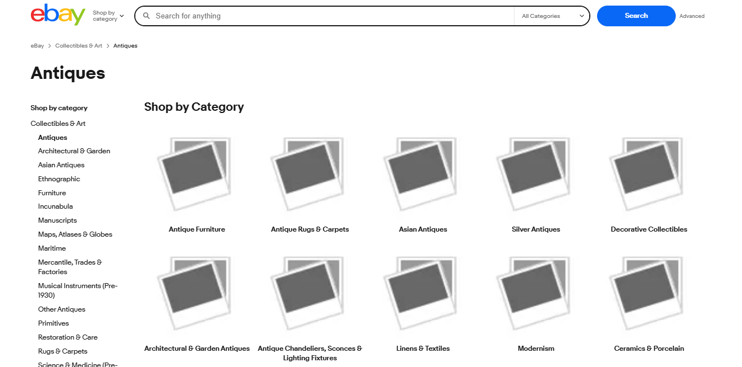

Slide 14
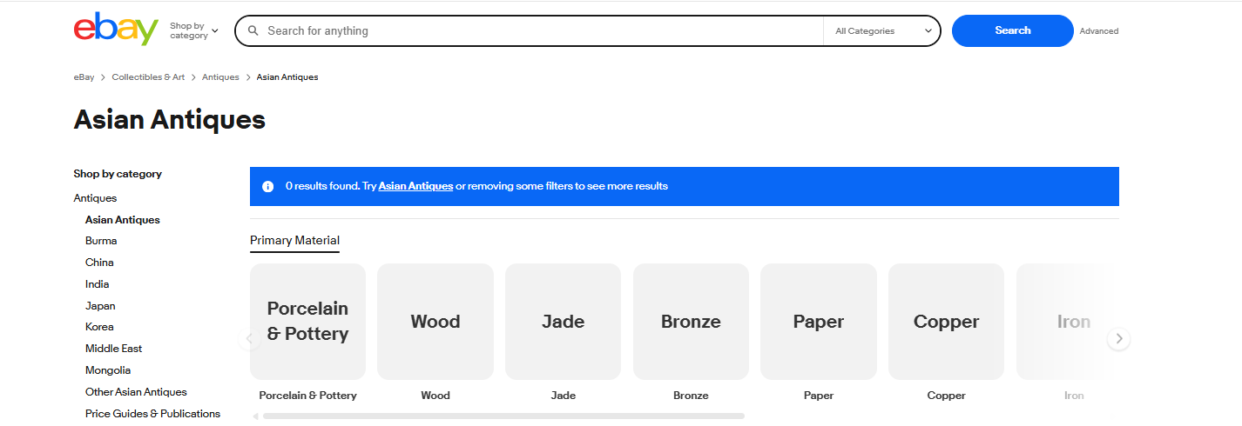

Slide 15
Challenges
While testing big website which contains huge data we faced some challenges about:
Understanding Questions: Sometimes it was hard to clearly understand what exactly Mam wanted in each test case.
Clearing Doubts: I had lots of doubts while making the test cases, but mam helped me solve them.
Finishing All Work: Doing all the test cases by myself took time and needed a lot of focus to make sure everything was done right.

Slide 16
Experience
Because of communication And discussion with Mam, it helped Me to write taste case in easy way.
Help to find out bugs.
Get to know Manual testing needs strong observation and in that testers needs to apply all possibilities in test cases.

Slide 17
Thank You!!!
Vaishali Mam For Guiding Us through out the Project.

